Slide 1
listen …

Slide 2
GES1011/GESS1009
The Evolution of a
Global City-State

Slide 3
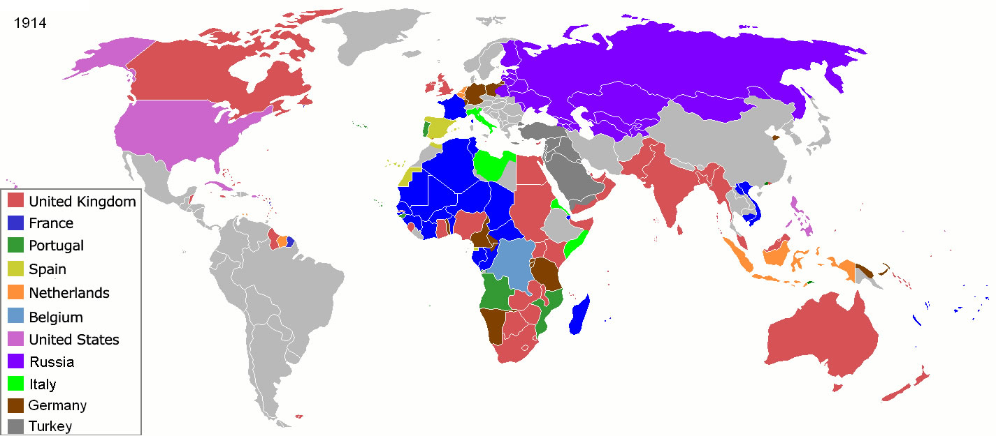
colonialism/imperialism…

Slide 4
our task today …
a second imperial encounter …
glimpses of the arrival of an imperial power ...
glimpses of how war experiences are remembered and storied ...
making sense of a second imperial encounter …
did you know ? a strangely worded document ...
interpreting Singapore’s past: imperial legacies …

Slide 5
recap …
watch …
imperialism (Japanese)

Slide 6
1941

Slide 7
1942-5

Slide 8
colonialism/imperialism…

Slide 9
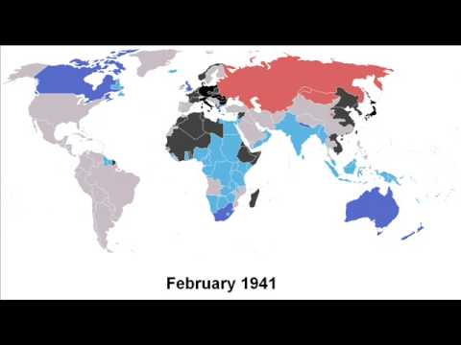
colonialism/imperialism…

Slide 10
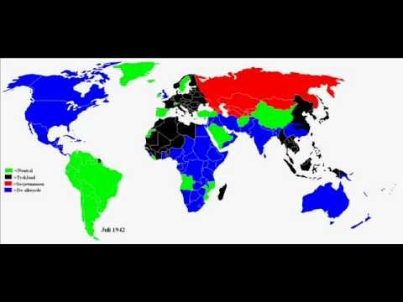
colonialism/imperialism…

Slide 11
imperial contest …
the Japanese advance in December 1941 in Kelantan …
Japanese-Siamese understanding …

Slide 12
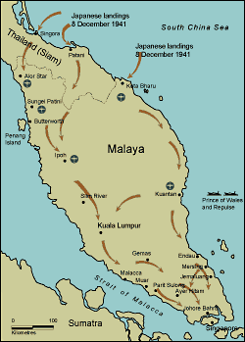
imperial contest …

Slide 13
imperial contest …
the fall of Singapore on 15 February 1942
British surrender …

Slide 14
imperial contest …
Japanese wartime authority …
administered from Singapore (Syonan), extending to ‘British Malaya’ and Sumatra …
in 1943, Kedah, Perlis, Kelantan, Terengganu under Siamese control pursuant to pre-invasion Siamese-Japanese pact …

Slide 15
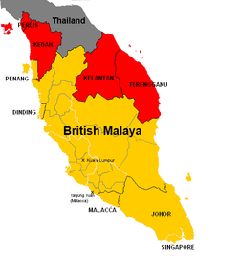
imperial contest …

Slide 16
what time is it?
Japanese turned the clocks in Syonan forward to Tokyo Standard Time (then a 1.5 hour difference) …
6:00am would become 7:30am
7:00pm would become 8:30pm
the Japanese embassy was also closed (to signal that Singapore was territorially part of Japan) …

Slide 17
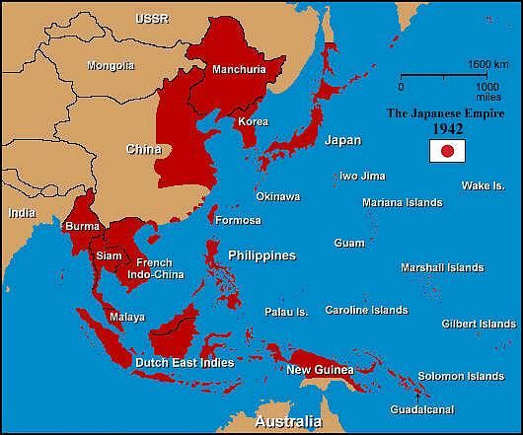
imperial contest …

Slide 18
imperial contest … …
Japanese leaders in Tokyo have aspirations of rallying an Asia-wide solidarity …
Greater East Asia Co-Prosperity Sphere …
Japanese also have natural resources like tin and rubber in mind in controlling British Malaya (like almost any other imperial power)
on the ground, actions of the lowest echelon (and most numerous) of Japanese military personnel quite capricious and unpredictable …

Slide 19
imperial contest …
all residents suffered the brunt of these personnel …
wartime difficulties in the form of scarcity expectedly led to conflict, inter-communal and otherwise … (story of human desperation)

Slide 20
imperial contest …
but the Chinese seem to have drawn the shortest straw receiving the worst treatment from Japanese, with the Malays getting better treatment …
groups of Malays seen as Japanese collaborators …
particularly those who assumed former British roles in the administration …
anti-Japanese struggle during war led mainly by Chinese …

Slide 21
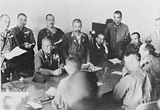
imperial contest …

Slide 22
imperial contest …
Singapore (Ford Factory in Bukit Timah) site of British surrender to Japanese …
what was Britain surrendering ?
Singapore? Malay States ? British Malaya? …
bits of its imperial domain …

Slide 23
imperial contest …
to another imperial power …
remember, the world then was carved up and controlled by several of industrialised imperial powers (war of empires) ...
which is why I think of this episode as an instance of imperial power transfer* …
more accurate than Pacific War, World War 2 , Japanese Occupation …
different labels, different inflections …

Slide 24
Singapore’s colonial identities ...
Singapore 1819/24-1826 ... British Colony
Straits Settlements (1826-1867) (Penang, Melaka, and S’pore)
Crown Colony of SS(1867-1942)
Syonan-to (1942-1945)

Slide 25
Question and Response

Slide 26
the imperialists remember…
Japanese leaders in Tokyo have aspirations of rallying an Asia-wide solidarity …
Greater East Asia Co-Prosperity Sphere …
Japanese Diet (Parliament) : ‘close control of Overseas Chinese in Malaya’ ...
interpretation 1: civilian (detention) camps …
interpretation 2: deal swiftly with suspects by killing them ...

Slide 27
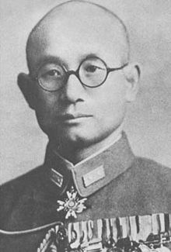
the imperialists remember…
Masanobu Tsuji …
Director of Military Operations of 25th Army …
wrote his ‘response’ to Churchill …
insights on strategy and planning …
narrative ends on 15 Feb 1942 …
therefore does not mention overseas Chinese purge …
disappeared in 1961 …

Slide 28
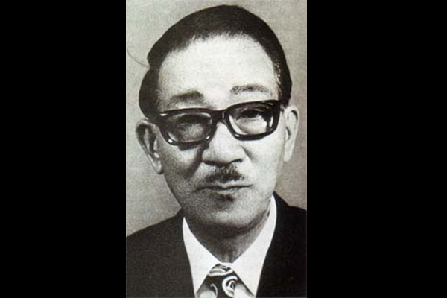
the imperialists remember…
Shinozaki Mamoru…
embassy officer
issued ‘Good Citizen’ passes …
helped found Overseas Chinese Association …
disagree that his Syonan- My Story was unadorned, straightforward and creditable …

Slide 29
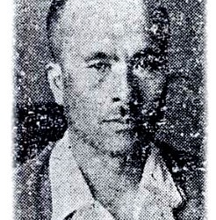
the imperialists remember…
Watanabe Wataru …
chief military administrator …
‘government by bayonet’…
aware of Singapore massacre third only to Nanking and Manila …
claims to be busy in his office and did not know anything about it …

Slide 30
the imperialists remember…
“Necessity is the mother of invention. When people meet with hardship, as in this war many did, their self-healing power is sharpened. Like weeds, they stretch to overcome any obstacle, waxing ever more luxuriant.”

Slide 31
the imperialists remember…
Wataru responsible for demanding 50 million dollars from Overseas Chinese in Malaya (includes S’pore) as compensation for Japanese military …
Wataru responsible for significant damage by reversing positive policies (Asian Co-Prosperity Sphere) …

Slide 32
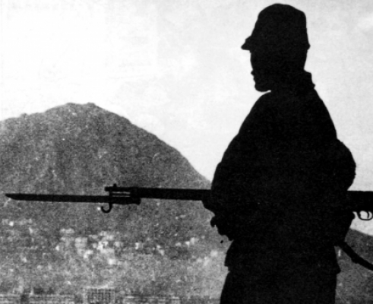
the imperialists remember…
Tsukushi Jiro, infantry officer …
wartime diary ...
received as heroes, even ‘divine’ heroes by locals ...
experience exotic delicacies like ‘coconut water’ ...
military ‘tourism’ ...
feeling invincible …

Slide 33
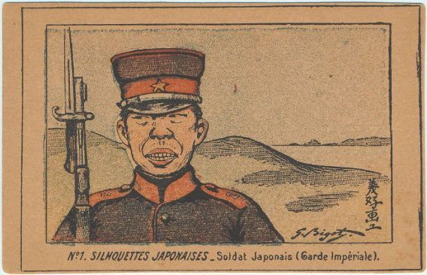
the imperialists remember…
Tsuchikane Tominosuke …
Imperial Guard …
1977 memoir ...
traces emergence from ‘boy’ to ‘man’ ...
from a ‘civilian’ (with a conscience) …
to a ‘warrior’ (killing without sentimentality)...

Slide 34
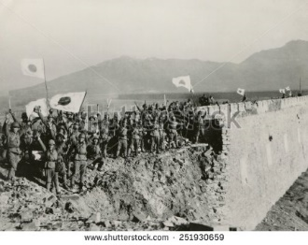
the imperialists remember…
Arai Mitsuo (1981) in old age (71) ...
offers details of battle ...
a bit pensive, somewhat nostalgic ...
Onishi Satoru (1977) …
Kempetai chief ...
soul searching …
apologetic for three big stains: display of severed heads, purge incident, money extortion ...

Slide 35
the imperialists remember…
Nagase Takashi …
interpreter …
in reference to newly arrived ‘virgin’ comfort women being reserved for superior …
hears their stories in language classes …
I am very, very sorry for what we have done here in the war ...

Slide 36
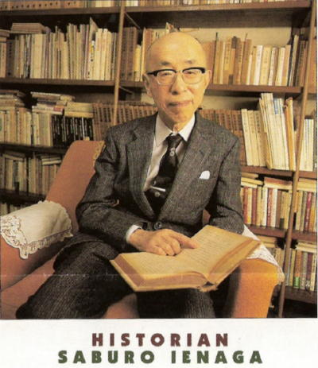
the imperialists remember…
‘The Pacific War’ (1960s)
‘War Guilt’ (1985)
addressed dark side of war …
listed brutalities …
to induce governmental remorse …

Slide 37
the imperialists remember…
led to other related research …
also pushback from those who claimed all wars are cruel …
why should Japan shoulder blame for a human catastrophe ???
(Marx hinted at this in his critique of capitalism; and tentacles of corporatism are at work again today)
(read Nietzsche, Marx and Freud before you graduate)

Slide 38
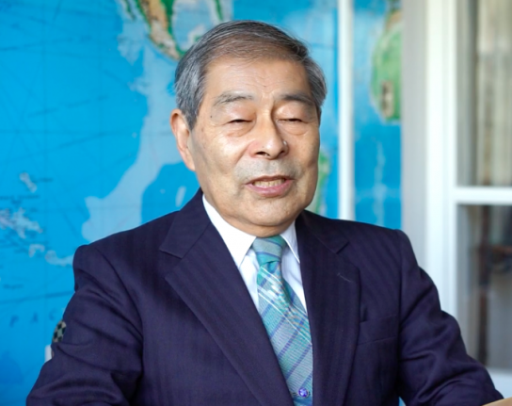
the imperialists remember…
Takashima Nobuyoshi
student of Kobayashi Masahiro (Japanese school teacher in SG) …
High school geography teacher …
researched troop behavior and massacres in Malaya …

Slide 39
the imperialists remember…
translated book published in by Chinese Malaysians …
flies groups of Japanese to southeast Asian war theatres …
visits memorial sites, graves and victims and their survivors …

Slide 40
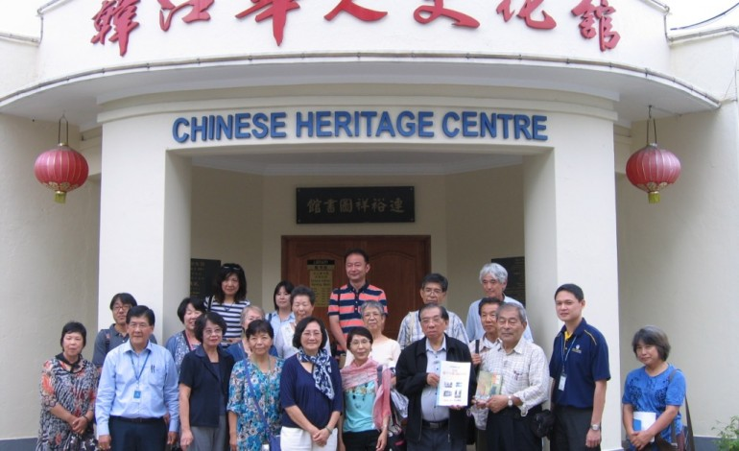
the imperialists remember…

Slide 41
Question and Response

Slide 42
midterm (further comments)

Slide 43
making sense of a second imperial encounter …
understanding the nuances of this imperial relationship …
Diet’s rhetoric, position and concerns …
translated differently by different men at different spots …

Slide 44
making sense of a second imperial encounter …
even in war theatre, differences of opinion between military and administrative/bureaucratic arms …
differences even at different levels of individual arms of Japanese presence …

Slide 45
making sense of a second imperial encounter …
does the imperial relationship eventually end (in this case; Japanese surrender) ?
remembering …
revising …
apologising …
reparations …

Slide 46
Question and Response

Slide 47
did you know ? a strangely worded document ...

Slide 49
Question and Response

Slide 50
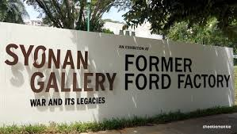
imperial legacies …

Slide 51
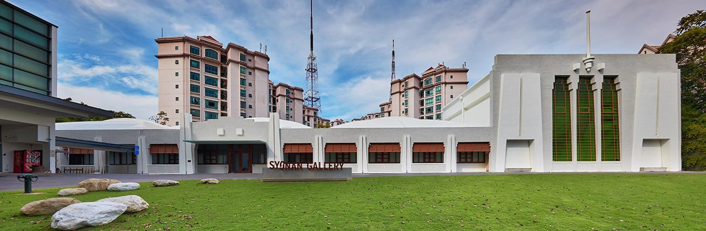
imperial legacies …

Slide 52
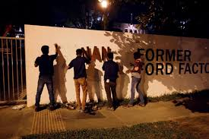
imperial legacies …

Slide 53
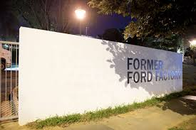
imperial legacies …

Slide 54
imperial legacies …
reopened as Syonan Gallery in February 2017 …
to coincide with 75th anniversary of British surrender …
public dissatisfaction with new name …
government relented after initial effort to justify its renaming …

Slide 55
imperial legacies …
do you agree with calling it Syonan?
do you think it the government was right in backing down?
what would be the content of your protest?
just the use of the term Syonan?

Slide 56
imperial legacies …
after all the furore …
all that has changed was the name of the museological complex …
nothing else was altered …
a case of much ado about form not substance ???

Slide 57
imperial legacies …
‘Singapore’ has at least TWO imperial experiences …
were these experiences significantly different ???
the longer British variant is remembered more positively than the shorter and apparently more brutal Japanese variety …
do you agree?
the Japanese said sorry (somewhat) …
are we waiting for a similar British act ???

Slide 58
imperial legacies
 | British | Japanese
arrival | preying on weakness; unequal treaty | military aggression; relieving another imperial power
length (till 1945) | 1819/24(26) – 1942 | 1942- 1945
rhetoric | God, Gold and Glory | Greater East Asia Co-Prosperity Sphere
reality | Greed (economic), Gore (Syed Yasin), Guns + God, Gold, Glory | Greed (economic), Rape, Murder, Torture, Drunken Ribaldry + aspects of rhetoric
end of war | returning morally superior civilizational warrior ??? | vanquished forces of evil ???
reparations | still waiting? | 1966 + subsequent general apologies at various war anniversaries + private efforts

Slide 59
whodunit ???
My father spoke of the terror when the Kempetei (the Japanese equivalent of the Gestapo) would arrive at the camp and scream out the names of ten men who were then ordered outside to dig their own graves. Nobody knew who would be called next-all they could do was listen to the shots being fired and the thud as the men fell.
Prisoners were starved of food and the camps were rife with cholera and dysentery. My father once told me he would eat anything he could find including frogs, spiders and snakes.

Slide 60
whodunit ???
My father spoke of the terror when the Kempetei (the Japanese equivalent of the Gestapo) would arrive at the camp and scream out the names of ten men who were then ordered outside to dig their own graves. Nobody knew who would be called next-all they could do was listen to the shots being fired and the thud as the men fell.
Prisoners were starved of food and the camps were rife with cholera and dysentery. My father once told me he would eat anything he could find including frogs, spiders and snakes.

Slide 61
whodunit ???
It was a culture of routine beatings, starvation, killings (the hanged represent only a small fraction of those who died in British custody during the Emergency) and torture of the most grotesque kinds. Alsatian dogs were used to terrify prisoners and then ‘maul’ them. There are other similarities with Abu Ghraib: various indignities were devised using human faeces; men were forced to sodomise one another. They also had sand, pepper and water stuffed in their anuses. One apparently had his testicles cut off, and was then made to eat them. ‘Things got a little out of hand,’ one (macho European) witness told Elkins, referring to another incident. ‘By the time we cut his balls off he had no ears, and his eyeball, the right one, I think, was hanging out of its socket. Too bad, he died before we got much out of him.’

Slide 62
whodunit ???
It was a culture of routine beatings, starvation, killings (the hanged represent only a small fraction of those who died in British custody during the Emergency) and torture of the most grotesque kinds. Alsatian dogs were used to terrify prisoners and then ‘maul’ them. There are other similarities with Abu Ghraib: various indignities were devised using human faeces; men were forced to sodomise one another. They also had sand, pepper and water stuffed in their anuses. One apparently had his testicles cut off, and was then made to eat them. ‘Things got a little out of hand,’ one (macho European) witness told Elkins, referring to another incident. ‘By the time we cut his balls off he had no ears, and his eyeball, the right one, I think, was hanging out of its socket. Too bad, he died before we got much out of him.’

Slide 63
whodunit ???
Lt Bill Drower, an interpreter at Kanburi Officers' camp in Thailand, dared to challenge his captors over one translation. He was severely beaten and kept in solitary confinement for the final 80 days of the war.
At the time of his rescue, following the Japanese surrender, he was close to death from malnutrition and blackwater fever, a rare but extremely dangerous complication of malaria.
On top of these horrific conditions, the majority of PoWs worked as slave labourers to keep Japan's heavy industry going. They toiled relentlessly on docks, airfields, in coalmines, shipbuilding yards, steel and copper works.

Slide 64
whodunit ???
Lt Bill Drower, an interpreter at Kanburi Officers' camp in Thailand, dared to challenge his captors over one translation. He was severely beaten and kept in solitary confinement for the final 80 days of the war.
At the time of his rescue, following the Japanese surrender, he was close to death from malnutrition and blackwater fever, a rare but extremely dangerous complication of malaria.
On top of these horrific conditions, the majority of PoWs worked as slave labourers to keep Japan's heavy industry going. They toiled relentlessly on docks, airfields, in coalmines, shipbuilding yards, steel and copper works.

Slide 65
whodunit ???
Women were gang-raped, had their nipples squeezed with pliers, and vermin and hot eggs thrust into their vaginas. Children were butchered and their body parts paraded around on spears. Then there were the pettier deprivations: women forbidden to sing hymns in Komiti camp, for example, because they were putting ‘subversive’ words to them. All this while anti-Mau Mau and pro-British propaganda blared out at detainees from loudspeakers.

Slide 66
whodunit ???
Women were gang-raped, had their nipples squeezed with pliers, and vermin and hot eggs thrust into their vaginas. Children were butchered and their body parts paraded around on spears. Then there were the pettier deprivations: women forbidden to sing hymns in Komiti camp, for example, because they were putting ‘subversive’ words to them. All this while anti-Mau Mau and pro-British propaganda blared out at detainees from loudspeakers.

Slide 67
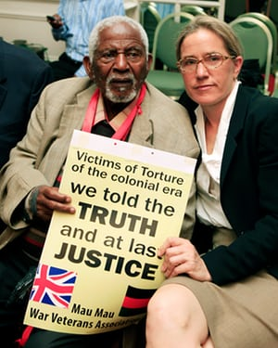
imperial legacies
Caroline Elkins
Imperial Reckoning: The Untold Story of the British Gulag in Kenya (2005)
Pulitzer Prize Winner 2006
GBP20 million

Slide 68
imperial legacies …

Slide 69
imperial legacies …
imperialism …

Slide 70
Question and Response

Slide 71
imperial legacies
 | British | Japanese
arrival | preying on weakness; unequal treaty | military aggression; relieving another imperial power
length (till 1945) | 1819/24(26) – 1942 | 1942- 1945
rhetoric | God, Gold and Glory | Greater East Asia Co-Prosperity Sphere
reality | Greed (economic), Gore (Syed Yasin), Guns + God, Gold, Glory | Greed (economic), Rape, Murder, Torture, Drunken Ribaldry + aspects of rhetoric
end of war | returning morally superior civilizational warrior ??? | vanquished forces of evil ???
reparations | still waiting? | 1966 + subsequent general apologies at various war anniversaries + private efforts

Slide 72
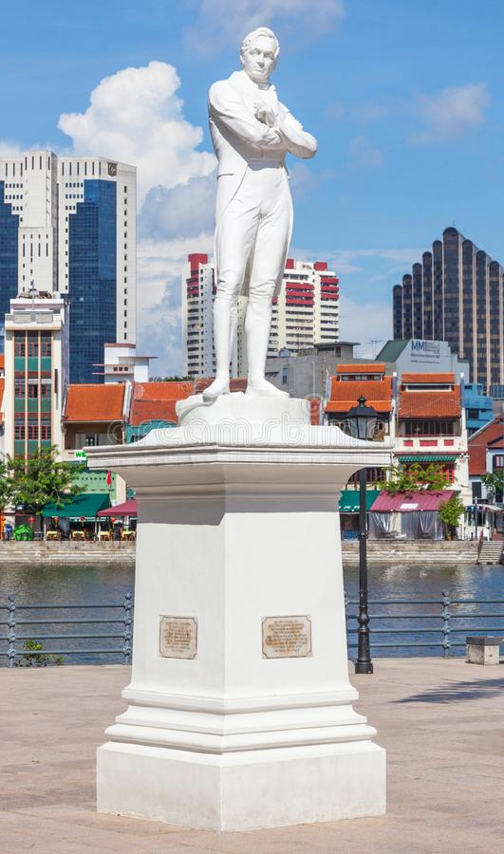
imperial legacies
seen it?
what should we do with it?
???

Slide 73
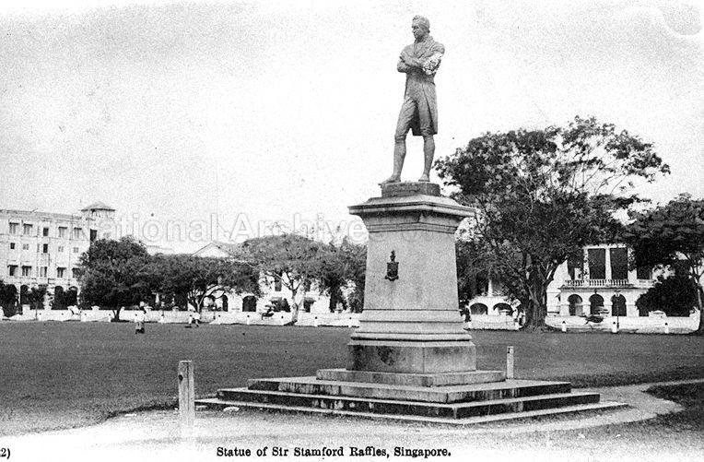
imperial legacies

Slide 74
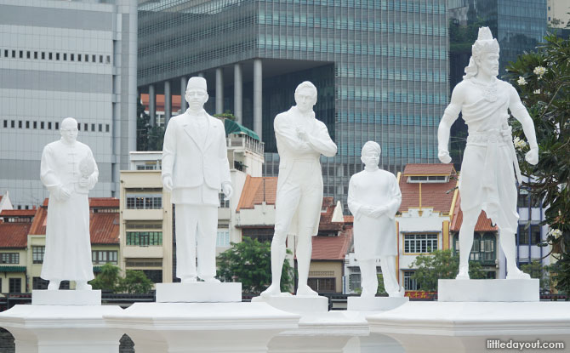
imperial legacies

Slide 75
imperial legacies
do imperial relationships ever come to an end ?
remembering …
revising …
apologising …
reparations …

Slide 76
Question and Response

